Slide 1
CySyphus
Kinetic Art Table
Final Presentation
sdDec20-4 Team Leader Email: adl@iastate.edu
Sean Gordon, Morgan Funk, Aaron Lawrence, Daniel Laracuenta, William Maston, and Samuel Christianson

Slide 2
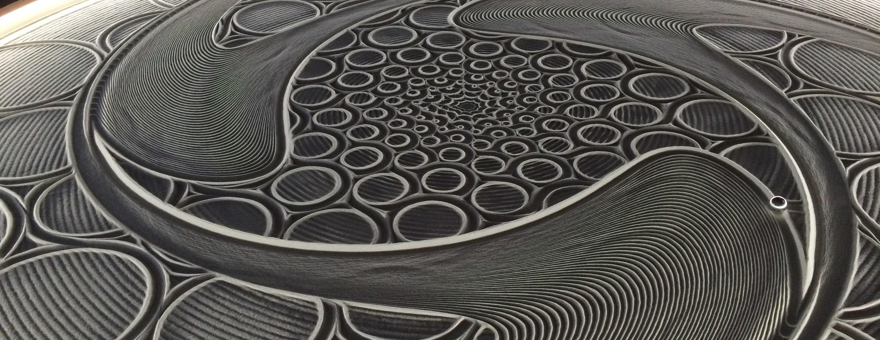
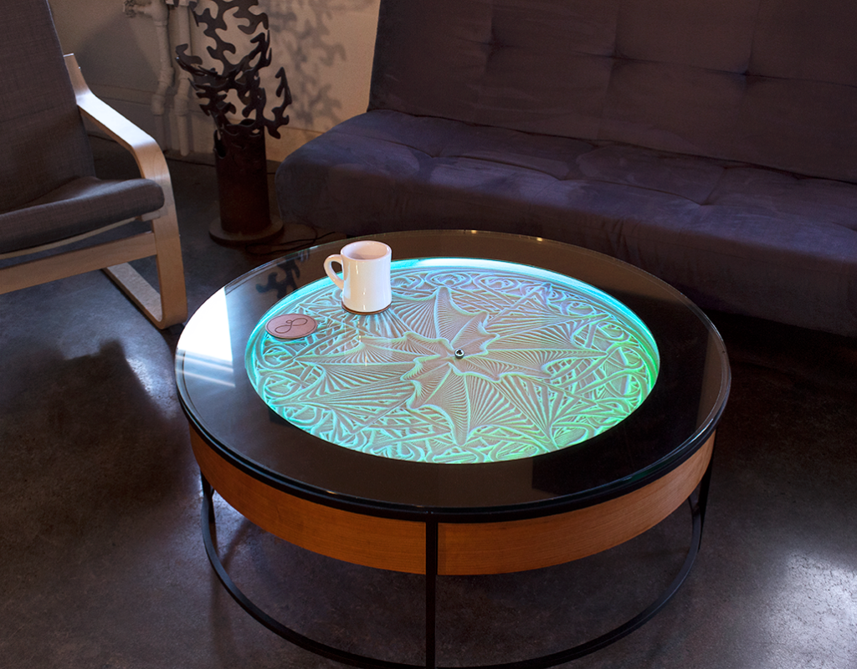
The Table
The table we have is a sisyphus coffee table designed and produced by Sisyphus Industries. Created by Bruce Shapiro, a artist that has been working with motion control as a artist medium for 25 years.
The table has a bed of sand that is shaped by a small magnetic ball. How it works is by utilizing a type of raspberry pi and a few servos or stepper motors to direct a magnet that pulls the ball along a predetermined programed track.
The computer is fed programs that take the form of rho theta files or scalable vector graphic files. These files can be created by any user. The table breaks down all files into theta rho files, theta can be thought of the angle our ball is within the table, rho is the distance the ball is from the center.
Notes:
Hi, my name is Aaron Lawrence and I will be talking about and introducing the table we worked with during our project. The table we will be working with is a Sisyphus coffee table designed and produced by Sisyphus industries. The creator, Bruce Shapiro, likes to describe the table as a mix between kinetic art, design and technology, these three together create a type of Zen garden.
The table main feature is a glass top that looks down to a bed of sand, this sand is slowly shaped into different designs and patterns that are selected by users. This shaping happens by dragging a small magnetic ball around in the sand to create these intricate and meaningful designs called tracks. These tracks are a single continuous path that is mapped out by a program that is given to the table. This is made possible by a raspberry pi that Sisyphus industries has worked on to develop, and a pair of stepper motors. This system connects through Wi-Fi to give a user control of the track itself and change things like track playlists, table colors, firmware ect. Users can also use this to upload their own designs to the table.
Tracks come in the form of Theta Rho files. Theta rho files are exactly that, a file filled with theta and rho values. Theta marks the position our ball can be around the table, this can be thought of as the angle our balls position is from the tables zero mark. This is measured in pi values, Rho is the distance our ball is from the center of the table, 1 being the rim and 0 being the center of the table. Once a track is given to the table it is processed and ran. The table does its best to smoothly transition from one point to the next, but the further the points are from each other, the more broken and incoherent a design can become.

Slide 3
Project Overview
For this project, we have created a website that allows users to submit images to be drawn onto the table. This drawing process is streamed live for all users on the website to view.
Images are processed and a file of continuously connected cartesian points is made, this file is then converted to polar points to allow for the table to properly draw the image.
The image is then streamed to the table via http postman requests.
Notes:
For this project we have created a website that allows users to submit images to be drawn on the table. This drawing process is streamed live for all users on the website to view.
Images that are sent to the table are processed and a file of continual cartesian points is created. This file is then converted to polar points to allow for the table to properly process and draw the image
This image is then streamed to the table via http postman requests from the web-server.

Slide 4
Front End - Overview
Tools Utilized - Github, Discord
Languages - Javascript, (JS) React library, HTML, CSS
Notes:
My name is Morgan Funk and I will be going over the Front end overview and covering the tools and languages we used during project development.
There were multiple tools that allowed us to establish a workflow while working remotely. One of these being git hub allowing each member working on the front end to establish version control and be able to pull from a working branch after any major updates. This allowed ease of work distribution and communication as we were able to assign web pages and widgets to issues and branch to work without affecting other members code.
For communication , our team mainly utilized Discord which is VoIP and Instant messaging platform which allowed us to be in constant communication and create posts/updates for team members who may not always be available. This platform also allowed for custom chat rooms and text channels which was helpful for keeping posts/information organized between members working on different aspects of the project.
Moving on to the languages utilized during development, the front end team agreed on developing with Javascript in order to utilize the React library that could be imported. This library heavily focused on UI and web page development which was easy to learn and use for members who were not as acclimated to JS. HTML and .css are used mainly for web page styling in to ensure a user friendly looking platform.

Slide 5
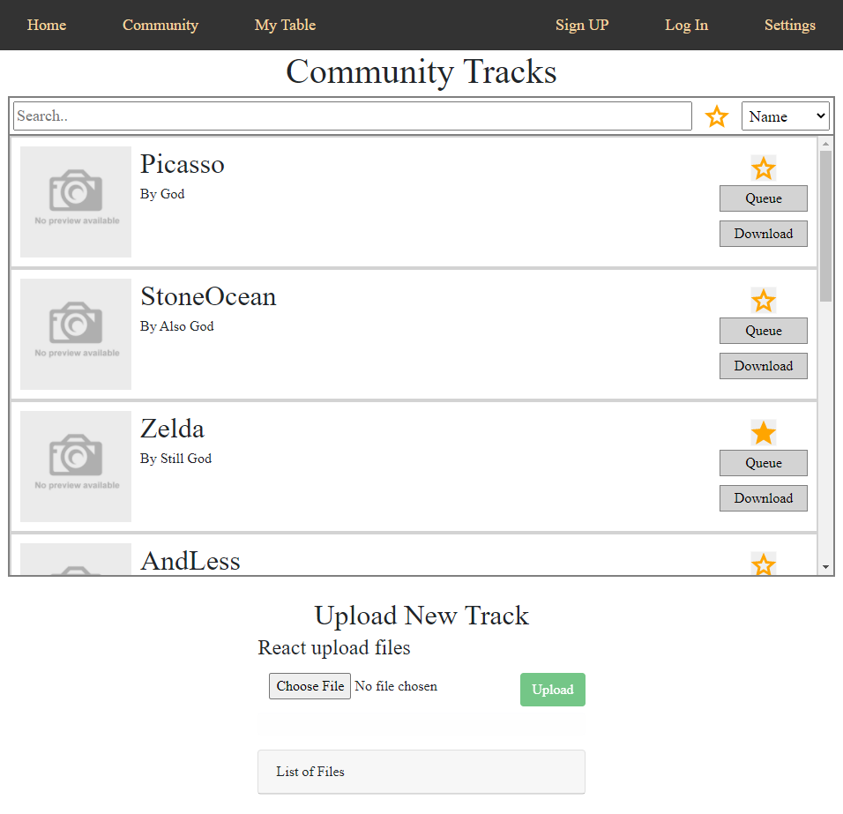
Front End (con) - Examples
Notes:
Next, we will quickly show some samples from our website.
When a user navigates to our project webpage, they will be greeted with the site homepage. This site includes an embedded link to our twitch stream of the team table, where the current drawing can be seen in-progress. Lower down is information on the project and the team members who worked on it. The navigation bar above allows quick navigation between different site functions.
On the community tracks page, the user can see and filter through a list of community uploaded tracks. They have the option to download the track file and, if they are logged in, are able to add the track to their favorites or queue the track to their own table. This page also allows a user to upload a new track to the site for anyone to see.
Script time: 0:35

Slide 6
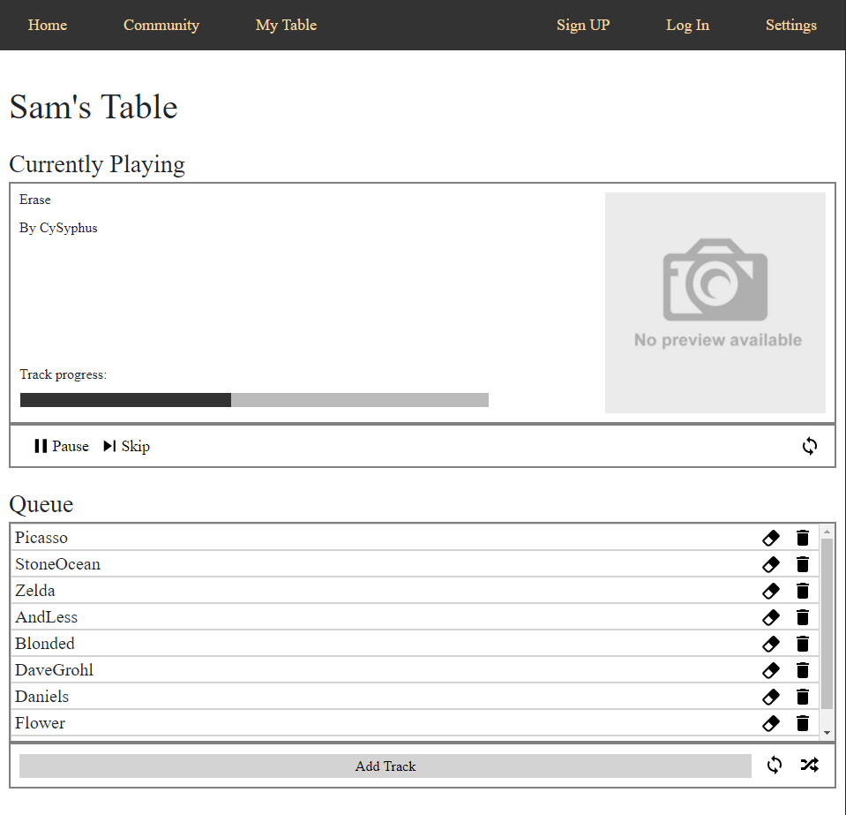
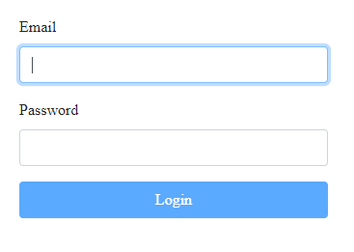
Front End (con) - Examples
After logging in and setting up their table,
user has access to their table’s currently
playing track, as well as the queue.
Notes:
After registering with our service and setting up their personal table, the user can log in and view or manipulate their table's currently playing track on the My Table page. This page also allows the user to view and modify their current queue, enabling full control of what is playing on the user's table.
Script time: 0:15

Slide 7
Back End
Tools Utilized - LAMP, Postman, GitHub
Language - Java | Framework - Spring
Database - MySQL

Slide 8
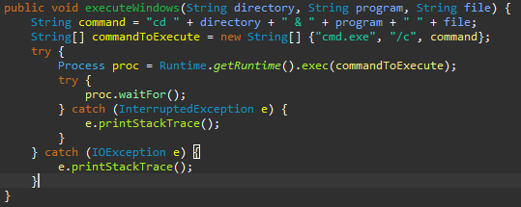
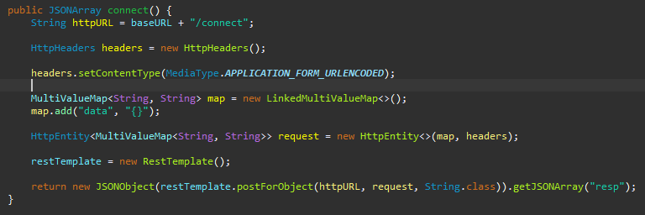
Back End (con)
Difficulties:
Executing python in spring
Managing file systems
Getting information from the table
Using the Requests provided

Slide 9
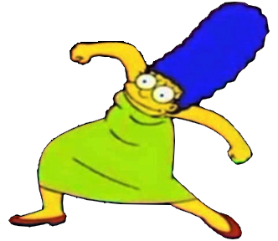
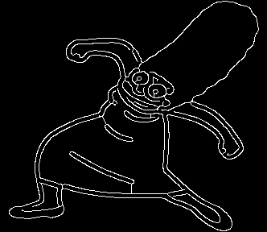
Image to Track
Custom python script, takes image as input and outputs track.
Script works in 4 stages:
Record object boundaries as edge segments.
Mark disjoint edge segments as individual components.
Draw connections between individual components.
Convert the connected components to a cartesian track.
The track is then nearly ready to be sent to the table.
Notes:
Next, I will be talking about our project's system for converting an image into a table track.
Before this project, users with a table that wanted a custom track would need to understand complex mathematics in order to build a track themselves. Each coordinate would need to be written in manually, or the specific function to be drawn had to be created. Part of our group's mission was to give users a larger amount of creative freedom with the table by enabling them to transform arbitrary images into table tracks.
The script we created to solve that problem works in 4 stages:
Stage 1: Record object boundaries as edge segments.
This section uses a technique called Canny edge detection to extract the edges of the shapes within an image. This algorithm, developed by John F. Canny, applies various filters and thresholds to a greyscale version of the image in question to extract a map of its edges. These edges do not form one long line, however, and cannot be traced with a marble. This leads us to...
Stage 2: Marking disjoint edge segments as individual components.
This stage walks through the map of edges, tagging each set of connected pixels as a connected component. These components are then passed over a second time, consolidating them into the smallest possible set of components. We then move to...
Stage 3: Drawing connections between individual components.
Once all individual line segments are marked as components, we need to connect them all efficiently. For this, a minimum spanning tree is employed, with each component as a node in the graph. Once created, the edges are drawn to connect each edge segment, and the result is sent to...
Stage 4: Converting the connected components to a cartesian track.
Starting from the closest edge pixel to the outside edge of the image, we then employ Breadth First Search to simulate tracing without lifting your pencil. This creates an ordered list of pixel coordinates, which are then converted to a sorted tree. This tree is then printed to a file, retracing steps to keep connections.
As the script itself is rather complicated, only a gist of it is discussed here. More information can be found in the documentation of the Image to Track script itself.
Script time: 1:55

Slide 10
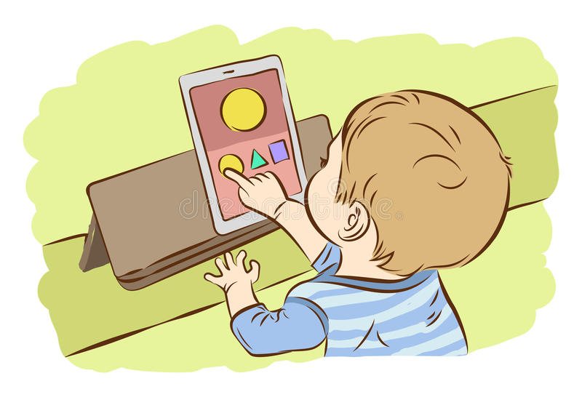
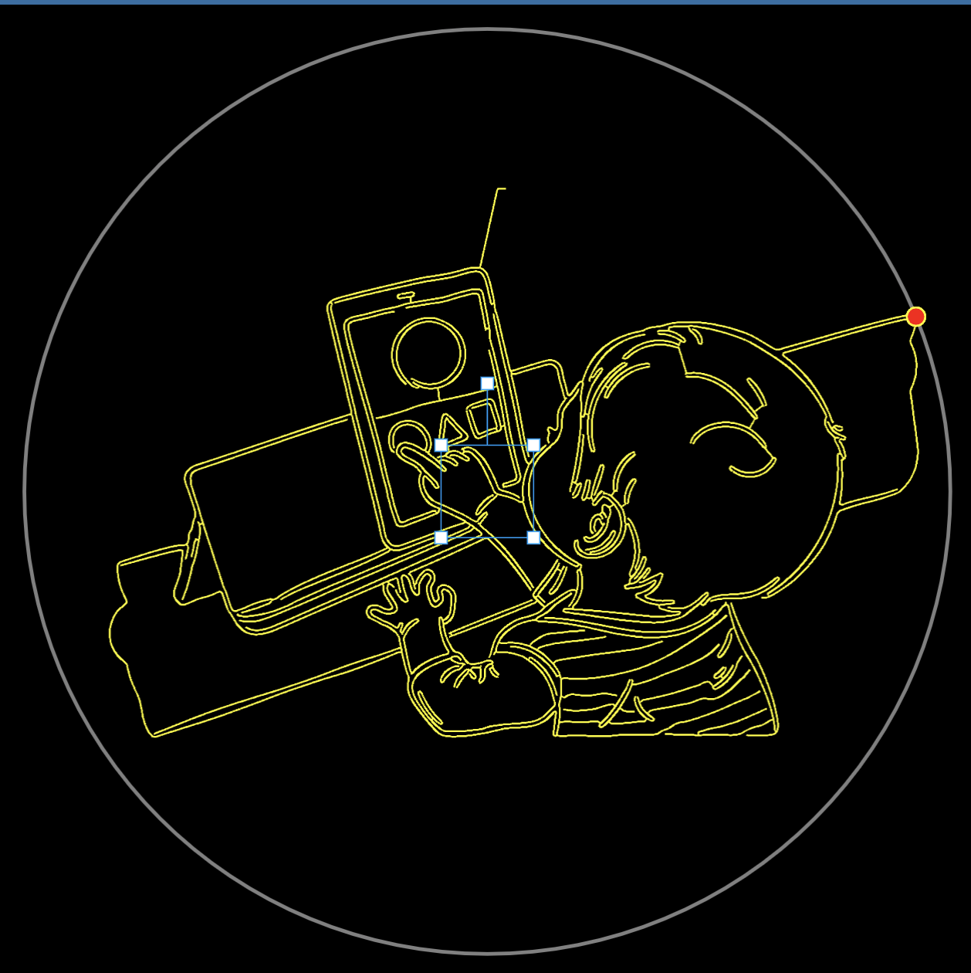
Table (CALCULATE)
Once an image was processed through ImageToTrack script, it needed to be formatted in a way that allowed the table to draw the image. This conversion script took in cartesian points and converted them into polar points. The script had to be formed around specific table track requirements.
In the unit conversion script we had to attend to different needs like:
Using a cartesian to polar conversion that the table’s computer could read and draw images from.
Centering the cartesian points to allow for an image to be drawn on the whole table rather than a single quadrant.
Scaling the image to perfectly use the whole drawing space of the table.
Starting and ending the track on the outer rim of the table to aid in minimizing table drawing errors and misalignment.
Notes:
Hello everyone! My name is Daniel Laracuenta and I will be talking about how we converted the image into a track and streamed it to the table.
Our process began with inputting an image into the ImageToTrack script in order to convert all the cartesian points into polar points, but in that process we also had to attend to different requirements the table needed to draw properly like
Using a properly formatted cartesian to polar conversion that the table could read.
Centering the image by processing the cartesian points so the drawing can be displayed throughout the whole table and not just one quadrant.
Scaling the image down in order to use the size of the table perfectly down to its edge.
And last but not least, minimizing potential drawing errors by starting and ending on the outer rim of the table.

Slide 11
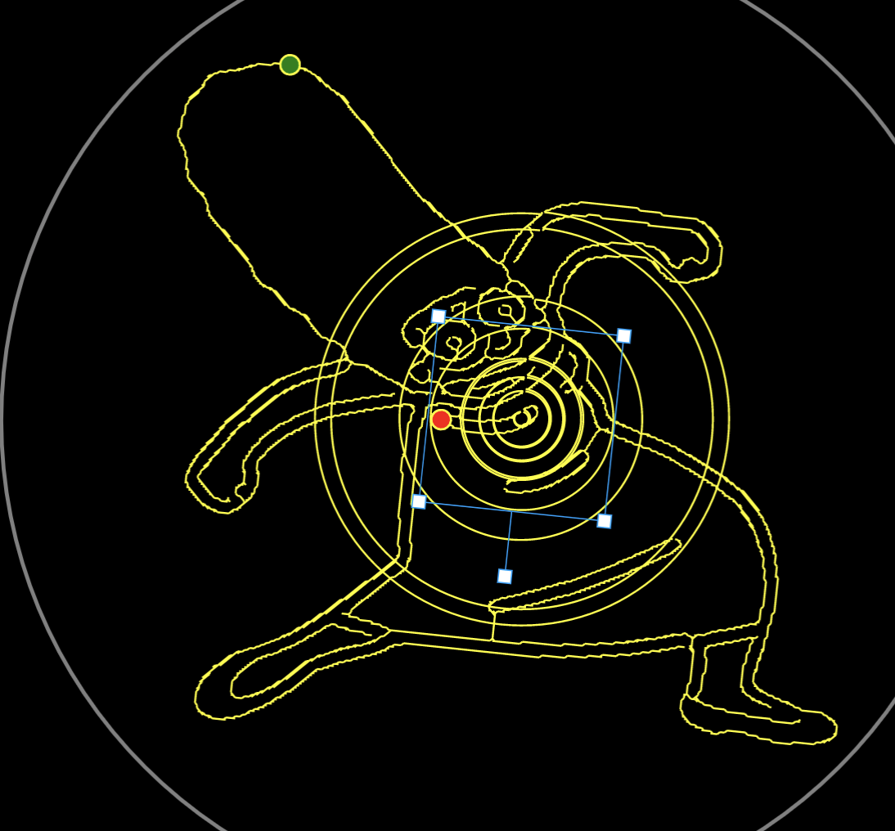
Table (con) (STREAMING DATA)
Among other things, we ran into some issues when trying to draw an image due to how the table was coded. The issue was that the conversion formula that we were using had a min and max value of -π and π. When a jump from a negative theta to a positive theta occured, the table saw the difference between two points as being ≈2π and so it would track the magnet a distance of 2π rather than crossing over this threshold and continuing the line drawing on the other quadrant of the table. This was fixed by detecting when this jump occurs and then allowing our theta value to continue growing beyond a value of -π or π.
Lastly, after putting in all the data points into a file, we streamed all the theta and rho points to the table using HTTP requests that go through thousands of data point lines, one line at a time.
Notes:
Next, I will be talking about how the data was streamed from the outputted file, which has all the data points, from our conversion algorithm to the table and some issues we ran into along the way.
As you can see on the image on the right there are multiple circles on top of the drawing that are essentially disrupting the image. This was because our conversion formula only had a minimum and maximum value of pi and negative pi which conflicted with the table due to how it was coded as a theta value jumping from a negative theta to a positive theta was seen as two points having a difference of approximately two pi by the table. What this means is that, rather than continuing the drawing on the other quadrants of the table, the table’s magnet would guide the ball a distance of 2pi instead. However, we fixed this, after some debugging, by detecting exactly where a jump in values was occurring and then letting the theta values continue to grow beyond -pi or pi.
Lastly, once the conversion from polar to cartesian was done we would stream each individual line from the theta rho file, which contained one data point per line on thousands of lines, to the table by using HTTP requests.

Slide 12
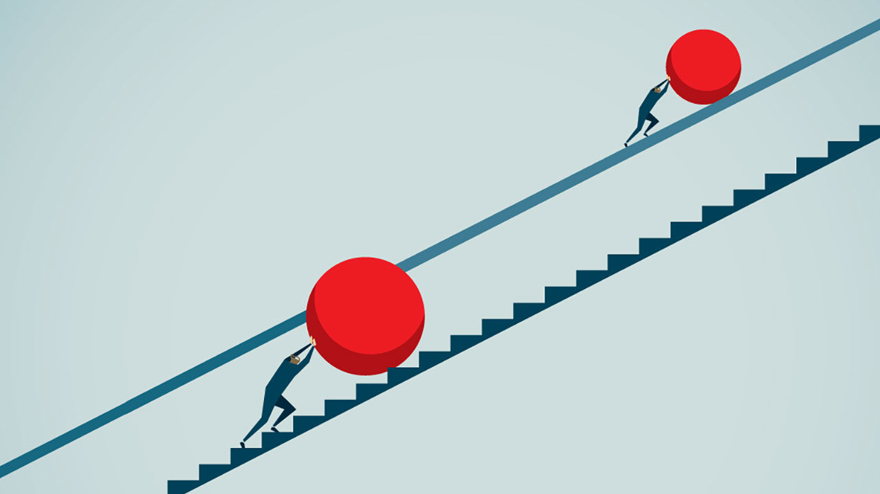
Project Obstacles
Working Remotely
Client communication
Deciphering Code given by Client
Scheduling Complications
Team Deadlines
Notes:
There have been many roadblocks and issues during this semester that have definitely impacted the development of this project. A major one mainly being that members had to work remotely due to current circumstances with the COVID 19 pandemic. It can be difficult to communicate points or issues fully when not in person especially when working through code or processes that are important to project development. This holds especially true when testing occurs with the table as not all members have access to the table to be able to get real feedback when working with code that interacts with the table.
Communication was also an issue when working with the Sisyphus team when trying to get code or get questions about the table answered. Email was our only communication available to the team and would sometimes take a few days to hear back which means there could be issues remaining unresolved for some time. In addition to this, the code we do receive may be a bit ambiguous or difficult to dissect and would take time to make operable. This would happen with some JSON functions which would all be thrown into one file without much in terms of organization.
Scheduling complications are mainly due to online classwork being readjusted and members needing to allocate time to other classes. This is also the case for team meetings and deadlines as many meeting times were subject to change

Slide 13
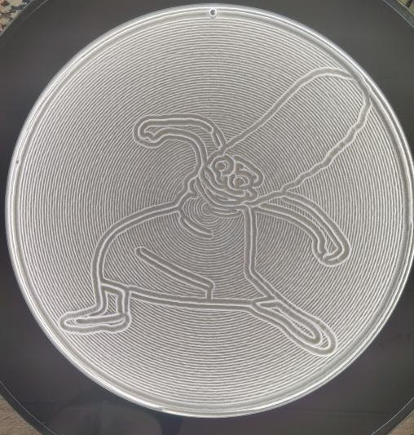
Final Results of our Efforts
Hooked up and operated on a Raspberry Pi
Created algorithms to convert images into usable polar coordinate files
Created a web server to hold files and send them to the Pi
Created a website for users to visit and submit images on
A fun and seamless way for user to interact with an art piece that is truly mesmerizing.
Notes:
Hi my name is William Maston, and I would like to finish this presentation by giving a quick wrap up of our final product, by going through the process of a user attempting interact with the table.
A user will first go online to our website to see our project, and twitch stream of what the table currently looks like and is drawing will be displayed. The user can then login to the website that our front end team designed to submit an image for display. That image is then sent over to the backend team.
They created a web server handle the image by putting it into a queue to be drawn, since multiple user may be attempting to submit to the same table. Images are processed into relevant files by scripts that our backend team were able to write. Once they reach the front of the queue, these files are streamed to the table.
The table team needed to handle the Pi, as well as the conversion of the files being sent so that the table could understand what to do. And all the while, a video camera is recording the whole process of the table starting to draw the image, and streaming it to twitch, which is being shown on the website so the user can see the results of their image submission.

Slide 14
What We Learned
Working with an existing code base
Interdisciplinary Collaboration between hardware and software focused team members
Independent teamwork and online collaboration through trying times
Researching and working with concepts that we may have learned about in school, but never had the chance to put into practice
Notes:
So what did we learn from working on this project.
Well for starters we all got a good exercise in working out of an existing code base. Engineers often have to join in projects in various level of completeness, and this requires a certain amount of onboarding. Starting from scratch is fun, but having to work out of an existing framework is more realistic and helpful to our learning experience.
This was also a first for some of our members to be working on a project where not everyone could easily do each others jobs. Many of us had specialized interests in hardware or software design, and would be unable to complete this project entirely on our own. We had to rely on each other to make sure this project was done correctly. This requires a level of trust and communication, that small scale projects fail to teach.
Thanks to current events, this project was also practice for a world that is moving towards remote working. We had to set up systems on the fly for holding meetings, setting deadlines, and collaborating, all while staying physically distant from each other. While covid will go away some day, the tools we gained from this will help us moving forward.
Lastly, this project was the capstone that each of us hoped it would be, allowing for the expression of all the lessons that we learned in class, but were never able to fully test or work with in the real world until now.

Slide 15
CySyphus
Kinetic Art Table
Questions?

Slide 16
Sections
The Table
Project Overview - 3.5 Min
Frontend - Overview/Programs used
Frontend - Javascript examples/link to show ?
Backend
Backend 2
Image to Track
Tableend
Tableend 2
Project Obstacles (Covid, client comms, shit table code)
What we ended up doing (Deliverables/Results)
What we learned
Aaron
Aaron
Morgan
Sean
Sam
Sam
Sean
Daniel
Daniel
Morgan
Will
Will

